Slide 1




A Retrieval Architecture for JWST Observations of Directly Imaged Exoplanets
Alex R. Howe
sites.lsa.umich.edu/feps
June 8, 2017
#aas230

Slide 2
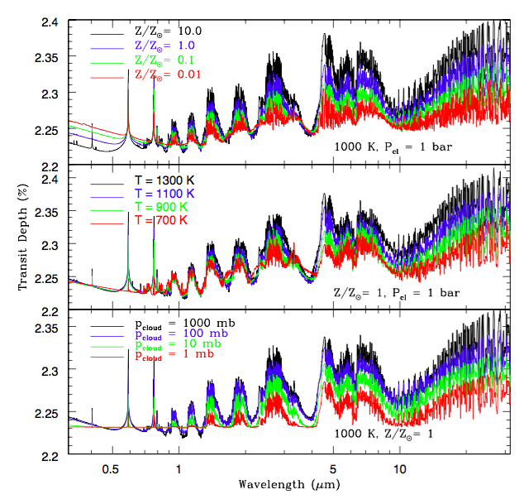
Model Transit Spectra
Howe, Burrows,
& Deming (2017)

Slide 3
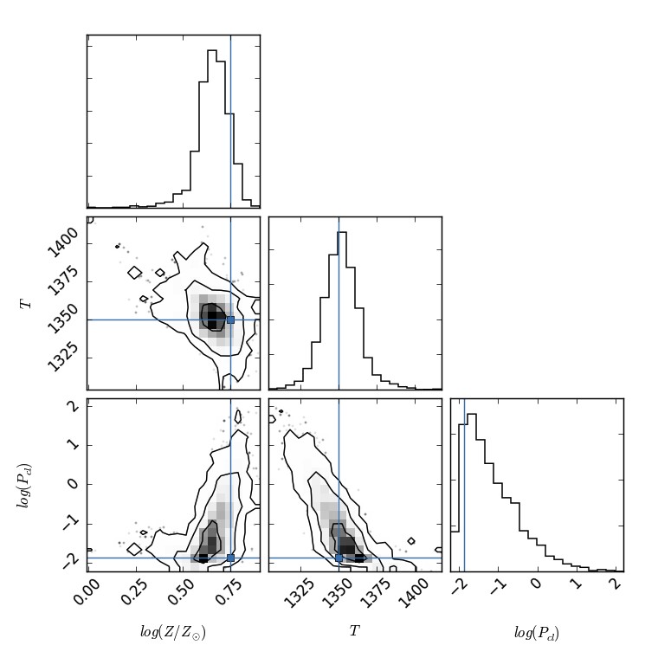
Sample Fit
1 hour observation
HAT-P-1b
NIRCam F444W
Howe, Burrows, &
Deming (2017)

Slide 4
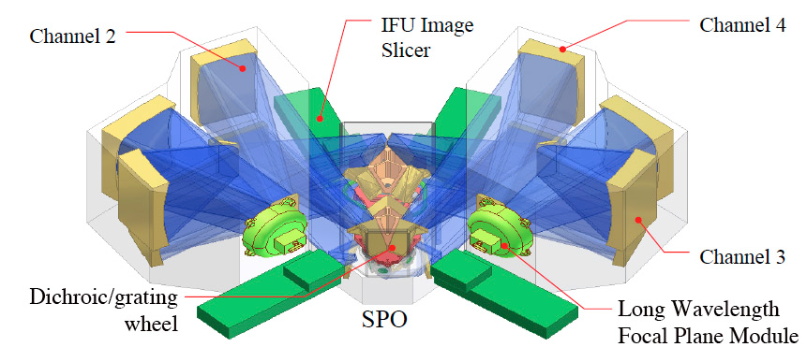
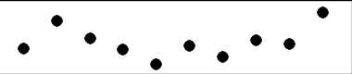
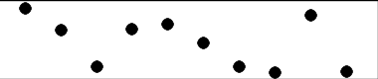
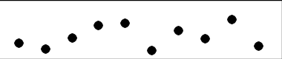
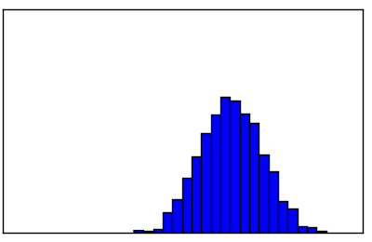
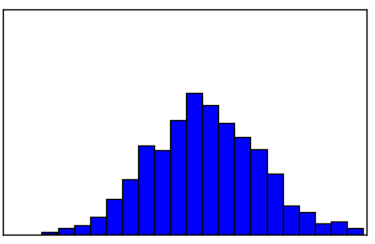
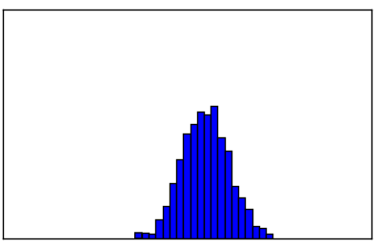
Bayesian Experiment Design
Instrument/
Observation
Possible Outcomes
Possible Results

Slide 5
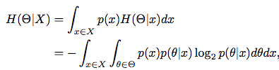

Mutual Information
Need the expectation value of information obtained from a given observation over all possible outcomes.
But for the amount of information gained from the observation, subtract the entropy of the prior.
This is mutual information: a statistical measure that quantifies the information obtained about one random variable through another random variable.
a

Slide 6
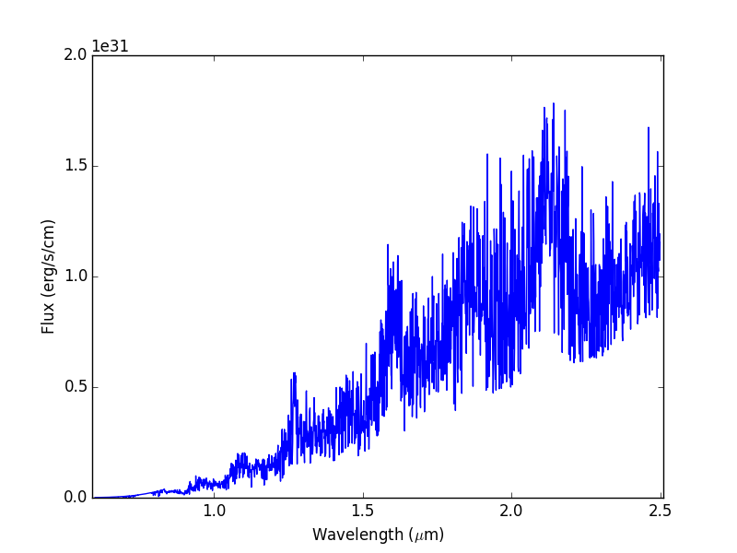
Model Emission Spectrum
Typical Hot Jupiter/Young Jupiter
Teff ~ 1200 K
NIRISS Band

Slide 7
Future Prospects
Reanalyze existing data, e.g. κ And b with new emission models with the latest opacities
Ongoing HST observations of resolved planetary mass companions
JWST transit and direct imaging observations
  NIRCam observations of resolved companions and isolated Y-dwarfs
  NIRISS observations, especially GJ 436b

